Slide 1
ARTIFICIAL INTELLIGENCE
CHAPTER NO 3

Slide 2
Chapter 1 (SLIDES END)
Do you think that the difference between the human brain and a computer is a fundamental one that can never be overcome. Or, is it merely a difference of complexity, one that can be surmounted?
The human brain is a product of millions of years of evolution and operates using biological processes, including consciousness, emotions, and intuition, which are not yet fully understood. Some argue that these aspects create a fundamental difference that cannot be replicated by machines.
What are your feelings about the concern that AI would render humans obsolete, or that intelligent machines would turn on their creators?
Concerns: There is a legitimate concern that AI could render certain jobs obsolete, leading to significant social and economic challenges. Automation and AI are already transforming industries, and without proper planning and adaptation, there could be substantial displacement of workers.
Turning on Creators: The fear of AI turning on its creators, often depicted in science fiction, stems from the idea of machines developing goals misaligned with human values. This is a serious concern in the field of AI safety and ethics, and researchers are actively working on ensuring that AI systems remain aligned with human intentions and values
If strong AI entity is developed, will it be aware? Why? Also, would we have the right to exploit the labor of sentient artificial beings, or would they deserve the same rights as humans?
If strong AI, or Artificial General Intelligence (AGI), were developed, it might possess self-awareness, consciousness, and the ability to understand and learn across any task. However, whether machines can truly be aware in the way humans are is still an open question.Exploiting a sentient being, regardless of its origins, would be morally questionable. Sentient beings would likely deserve rights and protections similar to humans, including the right to autonomy and fair treatment.

Slide 3
is it possible?
Driving in Lahore: Technologically possible but requires advanced AI and infrastructure adaptation.(tesla,waymo)
Robots for Household Tasks: Partially possible, with ongoing development for full automation.(roomba)
Automatic Grocery Ordering: Currently feasible and implemented.(instacart)
Smart Search Engines: Actively developed and significantly advanced.(google)
Smart AI Agents for Web Research: Feasible and in use across various sectors.(web-scarapers,bots)

Slide 4
1.1 Define in your own words: (a) intelligence, (b) artificial intelligence, (c) agent, (d) rationality, (e) logical reasoning.
Intelligence is the ability to acquire, understand, and apply knowledge and skills to solve problems, adapt to new situations, and think abstractly.
Artificial Intelligence (AI) is the field of computer science that focuses on creating machines and software capable of performing tasks that typically require human intelligence.
An agent is an entity that perceives its environment through sensors and acts upon that environment through actuators. In the context of AI, an agent is a software or robotic system designed to autonomously carry out specific tasks or achieve goals based on the information it gathers from its surroundings.
Rationality refers to the quality of making decisions or taking actions based on logic and reasoning rather than emotions or biases. It involves selecting the best possible option from available choices to achieve a specific goal
Logical reasoning is the process of using structured, systematic thinking to arrive at conclusions or solve problems.

Slide 5
1.3 Are reflexactions (such as flinching from a hot stove) rational? Are they intelligent?
Reflex actions can be considered rational in a biological sense because they are effective responses to potentially harmful stimuli.Reflex actions are not intelligent in the sense that they do not involve learning, reasoning, or conscious thought. They are pre-programmed, automatic responses that do not adapt or change based on experience.
1.4 Suppose we extend Evans’s ANALOGY program so that it can score 200 on a standard IQ test. Would we then have a program more intelligent than a human? Explain.
Scoring 200 on an IQ test does not necessarily mean the program is more intelligent than a human. It indicates that the program is exceptionally good at the types of problems featured in the IQ test but does not encompass the full range of human intelligence.

Slide 6
1.5 The neural structure of the sea slug Aplysia has been widely studied (first by Nobel Laureate Eric Kandel) because it has only about 20,000 neurons, most of them large and easily manipulated. Assuming that the cycle time for an Aplysia neuron is roughly the same as for a human neuron, how does the computational power, in terms of memory updates per second, compare with the high-end computer described in Figure 1.3?
The high-end computer described has a computational power that is approximately 24,000 times greater than the neural structure of the sea slug Aplysia in terms of memory updates per second. This significant difference highlights the advanced capabilities of modern computing hardware compared to the relatively simple neural networks of Aplysia.
1.6 How could introspection—reporting on one’s inner thoughts—be inaccurate? Could I be wrong about what I’m thinking? Discuss
Introspection, while a valuable tool for self-understanding, is prone to various sources of inaccuracy. Cognitive biases, memory distortions, unconscious processes, emotional influences, and social desirability can all lead to incorrect or incomplete self-reports. Therefore, it is possible to be wrong about what one is thinking, and introspective reports should be interpreted with an awareness of these limitations.

Slide 7
1.7 Towhat extent are the following computer systems instances of artificial intelligence: • Supermarket bar code scanners. • Websearch engines. • Voice-activated telephone menus. • Internet routing algorithms that respond dynamically to the state of the network.
Supermarket Bar Code Scanners: Low extent of AI, primarily involve simple automation and pattern recognition.
Web Search Engines: High extent of AI, utilizing advanced algorithms, natural language processing, and machine learning to deliver relevant results and personalize user experiences.
Voice-Activated Telephone Menus: Moderate extent of AI, employing speech recognition and natural language processing, with some systems incorporating learning for improved accuracy.
Internet Routing Algorithms: Moderate to high extent of AI, especially those using machine learning and optimization techniques for real-time adaptive decision-making.

Slide 8
1.8 Many of the computational models of cognitive activities that have been proposed in volve quite complex mathematical operations, such as convolving an image with a Gaussian or finding a minimum of the entropy function. Most humans (and certainly all animals) never learn this kind of mathematics at all, almost no one learns it before college, and almost no one can compute the convolution of a function with a Gaussian in their head. What sense does it make to say that the “vision system” is doing this kind of mathematics, whereas the actual person has no idea how to do it?
Automatic Brain Functions: Our brain does many complex tasks automatically, like seeing and reacting, without us needing to know the math involved.
Models Explain the Processes: Scientists use math to create models that explain how these brain functions work, even if we aren't aware of the math.
Evolution and Efficiency: Our brains have evolved to handle these tasks efficiently without needing conscious thought.

Slide 9
1.9 Why would evolution tend to result in systems that act rationally? What goals are such systems designed to achieve?1.10 Is AI a science, or is it engineering? Or neither or both? Explain
1.10: AI as Science: It involves studying and understanding the nature of intelligence through theoretical and empirical methods.
AI as Engineering: It focuses on the practical creation and optimization of intelligent systems and applications.
Evolution tends to favor rational behavior because it enhances survival and reproduction, leading to systems optimized for these goals
1.11 “Surely computers cannot be intelligent—they can do only what their programmers tell them.” Is the latter statement true, and does it imply the former?
The statement that computers do only what they are programmed to do is partially true but overlooks the capabilities of learning and adaptation in modern AI.Even if computers follow programmed instructions, the ability to learn, adapt, and exhibit complex behaviors can still be considered a form of intelligence.
1.12 “Surely animals cannot be intelligent—they can do only what their genes tell them.” Is the latter statement true, and does it imply the former
The statement that animals act only according to their genes is an oversimplification. It ignores the role of learning and environmental interaction in shaping behavior.The ability to learn, solve problems, and adapt demonstrates intelligence in animals. Thus, the latter statement does not imply the former.

Slide 10
1.13 “Surely animals, humans, and computers cannot be intelligent—they can do only what their constituent atoms are told to do by the laws of physics.” Is the latter statement true, and does it imply the former?
While it's true that animals, humans, and computers operate according to the laws of physics at the atomic level, intelligence is an emergent property that arises from complex interactions and processes within these systems. Therefore, the latter statement does not imply that animals, humans, and computers cannot be intelligent.

Slide 11
.
1.14 Examine the AI literature to discover whether the following tasks can currently be
solved by computers:
a. Playing a decent game of table tennis (Ping-Pong). YES
b. Driving in the center of Cairo, Egypt. NO
c. Driving in Victorville, California. YES
d. Buying a week’s worth of groceries at the market. NO
e. Buying a week’s worth of groceries on the Web. YES
f. Playing a decent game of bridge at a competitive level. YES
g. Discovering and proving new mathematical theorems. YES
h. Writing an intentionally funny story. NO
i. Giving competent legal advice in a specialized area of law. NO
j. Translating spoken English into spoken Swedish in real time. YES
k. Performing a complex surgical operation NO

Slide 12
CHAPTER 3
ALGOS

Slide 13
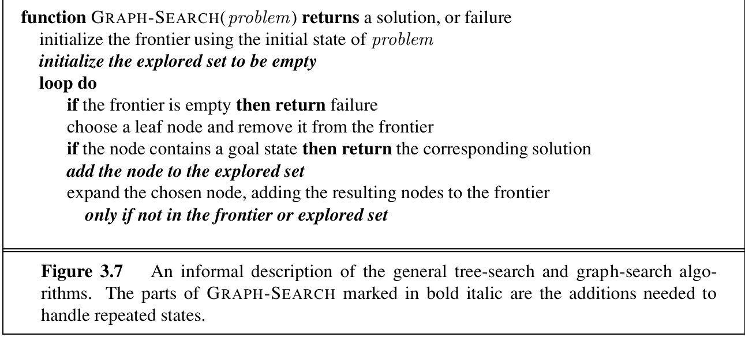
GRAPH SEARCH

Slide 14
BREADTH FIRST SEARCH
function BREADTH-FIRST-SEARCH(problem) returns a solution, or failure
node ←anodewith STATE = problem.INITIAL-STATE,PATH-COST =0
if problem.GOAL-TEST(node.STATE) then return SOLUTION(node)
frontier ←a FIFO queue with node as the only element
explored ←an empty set
loop do
if EMPTY?(frontier) then return failure
node ←POP(frontier) /* chooses the shallowest node in frontier */
add node.STATE to explored
for each action in problem.ACTIONS(node.STATE) do
child ←CHILD-NODE(problem,node,action)
if child.STATE is not in explored or frontier then
if problem.GOAL-TEST(child.STATE) then return SOLUTION(child)
frontier ←INSERT(child,frontier)

Slide 15
UNIFORM COST SEARCH
function UNIFORM-COST-SEARCH(problem) returns a solution, or failure
node ←anodewith STATE = problem.INITIAL-STATE,PATH-COST =0
frontier ←a priority queue ordered by PATH-COST, with node as the only element
explored ←an empty set
loop do
if EMPTY?(frontier) then return failure
node ←POP(frontier) /* chooses the lowest-cost node in frontier */
if problem.GOAL-TEST(node.STATE) then return SOLUTION(node)
add node.STATE to explored
for each action in problem.ACTIONS(node.STATE) do
child ←CHILD-NODE(problem,node,action)
if child.STATE is not in explored or frontier then
frontier ←INSERT(child,frontier)
else if child.STATE is in frontier with higher PATH-COST then
replace that frontier node with child

Slide 16
DEPTH LIMITED SEARCH
function DEPTH-LIMITED-SEARCH(problem,limit) returns a solution, or failure/cutoff
return RECURSIVE-DLS(MAKE-NODE(problem.INITIAL-STATE),problem,limit)
function RECURSIVE-DLS(node,problem,limit) returns a solution, or failure/cutoff
if problem.GOAL-TEST(node.STATE) then return SOLUTION(node)
else if limit =0then return cutoff
else
cutoff occurred?←false
for each action in problem.ACTIONS(node.STATE) do
child ←CHILD-NODE(problem,node,action)
result ←RECURSIVE-DLS(child,problem,limit − 1)
if result = cutoff then cutoff occurred?←true
else if result= failure then return result
if cutoff occurred? then return cutoff else return failur

Slide 17
ITERATIVE-DEEPENING
functionITERATIVE-DEEPENING-SEARCH(problem)returnsasolution,orfailure
fordepth=0to∞do
result←DEPTH-LIMITED-SEARCH(problem,depth)
ifresult=cutoffthenreturnresult

Slide 18
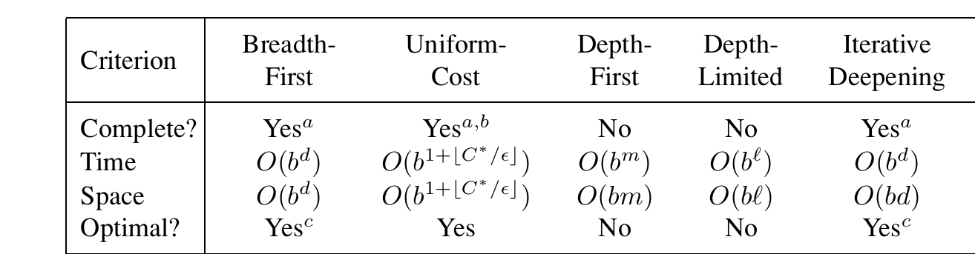
COMPARISON

Slide 19
Hill climbing
function HILL-CLIMBING(problem) returns a solution state
inputs: problem, a problem
static: current, a node
next, a node
current ← MAKE-NODE(INITIAL-STATE[problem])
loop do
next ← a highest-valued successor of current
if VALUE[next] ≤ VALUE[current] then return current
current ← next
end

Slide 20
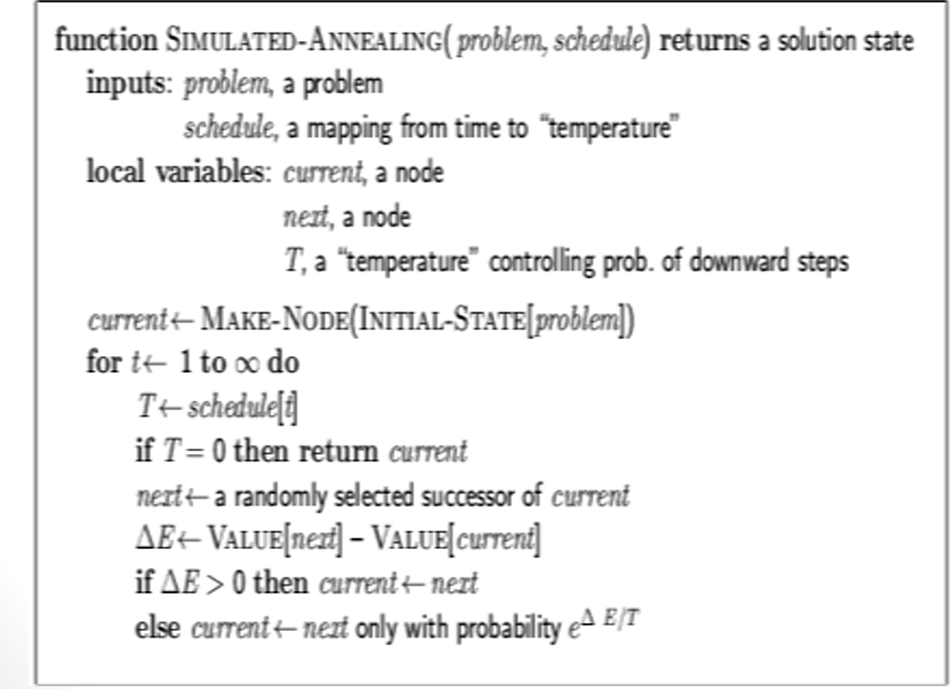
simulated annealing

Slide 21
3.1 Explain why problem formulation must follow goal formulation
In goal formulation, we decide which aspects of the world we are interested in, and which can be ignored or abstracted away. Then in problem formulation we decide how to manipulate the important aspects (and ignore the others). If we did problem formulation firstwe would not know what to include and what to leave out. That said, it can happen that there is a cycle of iterations between goal formulation, problem formulation, and problem solving until one arrives at a sufficiently useful and efficient solution

Slide 22
3.2 Your goal is to navigate a robot out of a maze. The robot starts in the center of the maze facing north. You can turn the robot to face north, east, south, or west. You can direct the robot to move forward a certain distance, although it will stop before hitting a wall. a. Formulate this problem. How large is the state space?
We’ll define the coordinate system so that the center of themaze is at (0,0), and themaze itself is a square from(−1,−1) to (1,1).
Initial state: robot at coordinate(0,0), facing North.
Goal test: either|x|>1or|y|>1 where(x,y) is the current location.
Successor function: move forwards any distance; change direction robot is facing.
Cost function: total distance moved.
The state space is infinitely large, since the robot’s position is continuous

Slide 23
b. In navigating a maze, the only place we need to turn is at the intersection of two ormore corridors. Reformulate this problem using this observation. How large is the state space now?
The state will record the intersection the robot is currently at, along with the directionit’s facing. At the end of each corridor leaving the maze we will have an exit node.We’ll assume some node corresponds to the center of the maze.
Initial state: at the center of the maze facing North.
Goal test: at an exit node.
Successor function: move to the next intersection in front of us, if there is one; turn toface a new direction.
Cost function: total distance moved.
There are 4n states, wherenis the number of intersections

Slide 24
c. From each point in the maze, we can move in any of the four directions until we reach aturning point, and this is the only action we need to do. Reformulate the problem using these actions. Do we need to keep track of the robot’s orientation now?
Initial state: at the center of the maze.
Goal test: at an exit node.
Successor function: move to next intersection to the North,South, East, or West.
Cost function: total distance moved.
We no longer need to keep track of the robot’s orientation since it is irrelevant to predicting the outcome of our actions, and not part of the goal test. The motor system that executes this plan will need to keep track of the robot’scurrent orientation, to knowwhen to rotate the robot.

Slide 25
d. In our initial description of the problem we already abstracted from the real world,restricting actions and removing details. List three such simplifications we made.
d. State abstractions:(i) Ignoring the height of the robot off the ground, whether it is tilted off the vertical.(ii) The robot can face in only four directions.(iii) Other parts of the world ignored: possibility of other robots in the maze, the weather in the Caribbean.
Action abstractions:(i) We assumed all positions we safely accessible: the robot couldn’t get stuck or damaged.(ii) The robot can move as far as it wants, without having to recharge its batteries.(iii) Simplified movement system: moving forwards a certain distance, rather than con-trolled each individual motor and watching the sensors to detect collisions

Slide 26
3.3 Suppose two friends live in different cities on a map, such as the Romania map shown in Figure 3.2. On every turn, we can simultaneously move each friend to a neighboring city on the map. The amount of time needed to move from city i to neighbor j is equal to the road distance d(i,j) between the cities, but on each turn the friend that arrives first must wait untilthe other one arrives (and calls the first on his/her cell phone) before the next turn can begin.We want the two friends to meet as quickly as possible. a. Write a detailed formulation for this search problem. (You will find it helpful to define some formal notation here.)
State space: States are all possible city pairs(i,j). The map is not the state space.
Successor function: The successors of(i,j)are all pairs(x,y)such that Adjacent(x,i) and Adjacent(y,j).
Goal: Be at(i,i)for some i.
Step cost function: The cost to go from (i,j) to (x,y) is max(d(i,x),d(j,y)).

Slide 27
b. LetD(i,j) be the straight-line distance between cities i and j. Which of the following heuristic functions are admissible? (i) D(i,j); (ii) 2 · D(i,j); (iii) D(i,j)/2
In the best case, the friends head straight for each other insteps of equal size, reducingtheir separation by twice the time cost on each step. Hence (iii) is admissible.
c. Are there completely connected maps for which no solution exists?
Yes: e.g., a map with two nodes connected by one link. The two friends will swap places forever. The same will happen on any chain if they start an odd number of steps apart. (One can see this best on the graph that represents the state space, which has two disjoint sets of nodes.)

Slide 28
d. Are there maps in which all solutions require one friend to visit the same city twice?
d. Yes: take any of the unsolvable maps from part (c) and add a self-loop to any one ofthe nodes. If the friends start an odd number of steps apart, amove in which one of thefriends takes the self-loop changes the distance by 1, rendering the problem solvable. Ifthe self-loop is not taken, the argument from (c) applies andno solution is possible

Slide 29
3.4 Show that the 8-puzzle states are divided into two disjoint sets, such that any state is reachable from any other state in the same set, while no state is reachable from any state in the other set.(Hint: See Berlekamp et al. (1982).) Devise a procedure to decide which set a given state is in, and explain why this is useful for generating random states.
legal move. In other words, after a legal move an odd Nremains odd whereas an even N remains even. Therefore the goal state in Figure 3.4, with noinversions and empty square inthe first row, has N= 1, and can only be reached from starting states with oddN, not from starting states with even N.Proof: First of all, sliding a tile horizontally changes neither the total number of in-versions nor the row number of the empty square.
Definition: The goal state has the numbers in a certain order, which we will measure as starting at the upper left corner, then proceeding left to right, and when we reach the end of a row, going down to the leftmost square in the row below. For any other configuration besides the goal, whenever a tile with a greater number on it precedes a tile with a smaller number,the two tiles are said to be inverted.
Proposition: For a given puzzle configuration, let N denote the sum of the total numberof inversions and the row number of the empty square. Then (Nmod2) is invariant under any

Slide 30
continued
Therefore let us consider sliding a tilevertically.Let’s assume, for example, that the tileAis located directly over the empty square.Sliding it down changes the parity of the row number of the empty square. Now consider thetotal number of inversions. The move only affects relative positions of tilesA,B,C, andD.If none of theB,C,Dcaused an inversion relative toA(i.e., all three are larger thanA) thenafter sliding one gets three (an odd number) of additional inversions. If one of the three issmaller thanA, then before the moveB,C, andDcontributed a single inversion (relative toA) whereas after the move they’ll be contributing two inversions - a change of 1, also an oddnumber. Two additional cases obviously lead to the same result. Thus the change in the sumNis always even. This is precisely what we have set out to show.So before we solve a puzzle, we should compute theNvalue of the start and goal stateand make sure they have the same parity, otherwise no solution is possible

Slide 31
3.5 Consider the n-queens problem using the “efficient” incremental formulation given on page 72. Explain why the state space has at least 3√n! states and estimate the largest n for which exhaustive exploration is feasible. (Hint: Derive a lower bound on the branching factor by considering the maximum number of squares that a queen can attack in any column.)
3.5The formulation puts one queen per column, with a new queen placed only in a squarethat is not attacked by any other queen. To simplify matters,we’ll first consider then–rooksproblem. The first rook can be placed in any square in column 1 (nchoices), the second inany square in column 2 except the same row that as the rook in column 1 (n−1choices), andso on. This givesn!elements of the search space.Fornqueens, notice that a queen attacks at most three squares in any given column, soin column 2 there are at least(n−3)choices, in column at least(n−6)choices, and so on.
Thus the state space sizeS≥n_x0001_(n−3)_x0001_(n−6)_x0001__x0001__x0001_.
Hence we have
S3≥n_x0001_n_x0001_n_x0001_(n−3)_x0001_(n−3)_x0001_(n−3)_x0001_(n−6)_x0001_(n−6)_x0001_(n−6)_x0001__x0001__x0001__x0001_
≥n_x0001_(n−1)_x0001_(n−2)_x0001_(n−3)_x0001_(n−4)_x0001_(n−5)_x0001_(n−6)_x0001_(n−7)_x0001_(n−8)_x0001__x0001__x0001__x0001_=n!
S≥3√n!

Slide 32
3.6 Give a complete problem formulation for each of the following. Choose a formulation that is precise enough to be implemented. a. Using only four colors, you have to color a planar map in such a way that no two adjacent regions have the same color.
a. Initial state: No regions colored.
Goal test: All regions colored, and no two adjacent regions have the same color.
Successor function: Assign a color to a region.
Cost function: Number of assignments

Slide 33
b. A 3-foot-tall monkey is in a room where some bananas are suspended from the 8-foot ceiling. He would like to get the bananas. The room contains two stackable, movable, climbable 3-foot-high crates
Initial state: As described in the text.
Goal test: Monkey has bananas.
Successor function: Hop on crate; Hop off crate; Push crate from one spot to another;Walk from one spot to another; grab bananas (if standing on crate).
Cost function: Number of actions

Slide 34
c. You have a program that outputs the message “illegal input record” when fed a certain file of input records. You know that processing of each record is independent of the other records. You want to discover what record is illegal.
Initial state: considering all input records.
Goal test: considering a single record, and it gives “illegal input” message.
Successor function: run again on the first half of the records; run again on the secondhalf of the records.
Cost function: Number of runs.
Note: This is a contingency problem; you need to see whether a run gives an errormessage or not to decide what to do next.

Slide 35
d.You have three jugs, measuring 12 gallons, 8 gallons, and 3 gallons, and a water faucet. You can fill the jugs up or empty them out from one to another or onto the ground. You need to measure out exactly one gallon.
Initial state: jugs have values[0,0,0].
Successor function: given values[x,y,z], generate[12,y,z],[x,8,z],[x,y,3](by fill-ing);[0,y,z],[x,0,z],[x,y,0](by emptying); or for any two jugs with current values x and y, pour y into x; this changes the jug with x to the minimum of x+y and the capacity of the jug, and decrements the jug withyby by the amount gained by the first jug.
Cost function: Number of actions
Goal Test: meausre upto one gallon.

Slide 36
3.7 Consider the problem of finding the shortest path between two points on a plane that has convex polygonal obstacles as shown in Figure 3.31. This is an idealization of the problem that a robot has to solve to navigate in a crowded environment. a. Suppose the state space consists of all positions (x,y) in the plane. How many states are there? How many paths are there to the goal?
If we consider all(x,y)points, then there are an infinite number of states, and of paths
b. Explain briefly why the shortest path from one polygon vertex to any other in the scene must consist of straight-line segments joining some of the vertices of the polygons.Define a good state space now. How large is this state space?
The shortestdistance between two points is a straight line, and if it is not possible to travel in astraight line because some obstacle is in the way, then the next shortest distance is asequence of line segments, end-to-end, that deviate from the straight line by as littleas possible. So the first segment of this sequence must go fromthe start point to atangent point on an obstacle – any path that gave the obstaclea wider girth would belonger. Because the obstacles are polygonal, the tangent points must be at vertices ofthe obstacles, and hence the entire path must go from vertex to vertex.

Slide 37
3.8 Onpage 68, we said that we would not consider problems with negative path costs. In this exercise, we explore this decision in more depth. a. Suppose that actions can have arbitrarily large negative costs; explain why this possi bility would force any optimal algorithm to explore the entire state space
Any path, no matter how bad it appears, might lead to an arbitrarily large reward (nega-tive cost). Therefore, one would need to exhaust all possible paths to be sure of findingthe best one.
b. Does it help if we insist that step costs must be greater than or equal to some negative constant c? Consider both trees and graphs.
Suppose the greatest possible reward isc. Then if we also know the maximum depth ofthe state space (e.g. when the state space is a tree), then anypath withdlevels remainingcan be improved by at mostcd, so any paths worse thancdless than the best path can bepruned. For state spaces with loops, this guarantee doesn’thelp, because it is possibleto go around a loop any number of times, picking upcreward each time.
c. Suppose that a set of actions forms a loop in the state space such that executing the set in some order results in no net change to the state. If all of these actions have negative cost,what does this imply about the optimal behavior for an agent in such an environment?
The agent should plan to go around this loop forever (unless it can find another loop with even better reward).

Slide 38
d. One can easily imagine actions with high negative cost, even in domains such as route finding. For example, some stretches of road might have such beautiful scenery as to far outweigh the normal costs in terms of time and fuel. Explain, in precise terms, within the context of state-space search, why humans do not drive around scenic loops indefinitely, and explain how to define the state space and actions for route finding so that artificial agents can also avoid looping.
Humans do not drive around scenic loops indefinitely for several reasons:
Goal-Oriented Behavior: Humans typically have a specific destination or purpose in mind when they travel, which overrides the temptation to continue circling scenic routes.
Awareness of Time and Resources: Practical considerations such as time, fuel, and the need to reach a destination limit the willingness to drive aimlessly.
Memory and Planning: Humans have cognitive abilities to remember the routes they have taken and plan their journeys to avoid redundancy and inefficiency.
e. Can you think of a real domain in which step costs are such as to cause looping?

Slide 39
.
(a) Problem Formulation
The Missionaries and Cannibals Problem can be formulated with the following constraints and state space:
State Representation:
Each state can be represented as a tuple (𝑀,𝐶,𝐵)
(M,C,B) where:
M is the number of missionaries on the left bank.
C is the number of cannibals on the left bank.
B is the position of the boat, where 0 represents the left bank and 1 represents the right bank.
Initially, the state is (3,3,0), meaning all missionaries and cannibals are on the left bank, and the boat is also on the left bank.
Goal State:The goal is to reach the state (0,0,1), where all missionaries and cannibals are on the right bank, and the boat is on the right bank.
Actions:
The boat can carry one or two people across the river. The possible actions include:
One missionary crosses the river.
Two missionaries cross the river.
One cannibal crosses the river.
Two cannibals cross the river.
One missionary and one cannibal cross the river.
Validity Constraints:
Missionaries should never be outnumbered by cannibals on either bank unless there are no missionaries on that bank.
The boat must carry at least one person.

Slide 40
3.10 Define in your own words the following terms: state, state space, search tree, search node, goal, action, transition model, and branching factor.
State:
A state represents a specific configuration or situation of the environment at a given point in time.
State Space:
The state space is the set of all possible states that can be reached in a given problem. It encompasses every potential configuration from the initial state to the goal state.
Search Tree:
A search tree is a tree structure used to represent the progression of states explored by a search algorithm. Each node in the tree corresponds to a state, and the edges represent the actions taken to move from one state to another
Search Node:
A search node is an element in the search tree that represents a state, including additional information such as the path cost to reach that state and the action taken to get there.
Goal:
The goal is the desired outcome or the specific state that the search algorithm aims to achieve. In the context of a problem, it is the condition that signifies a successful solution.
Action:
An action is an operation that causes a transition from one state to another. It defines how the state changes in response to an event or decision taken by the agent.
Transition Model:
The transition model defines how actions transform states. It specifies the rules or functions that determine the resulting state when an action is applied to the current state.
Branching Factor:
The branching factor is the average number of successors or child nodes generated from a single node in the search tree. It represents the number of possible actions available at each state.

Slide 41
3.11 What’s the difference between a world state, a state description, and a search node? Whyis this distinction useful?
The world state refers to the actual, complete, and precise configuration of the entire environment at a particular moment.
The state description is an abstraction or representation of the world state, capturing only the relevant aspects needed for solving a specific problem.
A search node is a data structure used in search algorithms that includes a state description and additional information such as the path cost to reach that state, the parent node, and the action taken to get to that state.

Slide 42
3.12 Anaction such asGo(Sibiu) really consists of a long sequence of finer-grained actions: turn on the car, release the brake, accelerate forward, etc. Having composite actions of this kind reduces the number of steps in a solution sequence, thereby reducing the search time. Suppose we take this to the logical extreme, by making super-composite actions out of every possible sequence of Go actions. Then every problem instance is solved by a single super composite action, such as Go(Sibiu)Go(Rimnicu Vilcea)Go(Pitesti)Go(Bucharest). Explain how search would work in this formulation. Is this a practical approach for speeding up problem solving?
While the idea of using super-composite actions could theoretically reduce search time by simplifying the sequence of steps, it is not practical due to the significant increase in the number of actions that need to be managed. The balance between the granularity of actions and the efficiency of the search algorithm must be carefully maintained to ensure both practical feasibility and optimal performance. Thus, while super-composite actions can be beneficial in some contexts, they are generally impractical for speeding up problem solving in complex or dynamic environments.

Slide 43
3.13 Prove that GRAPH-SEARCH satisfies the graph separation property illustrated in Fig ure 3.9. (Hint: Begin by showing that the property holds at the start, then show that if it holds before an iteration of the algorithm, it holds afterwards.) Describe a search algorithm that violates the property
Conclusion
The proof shows that GRAPH-SEARCH maintains the graph separation property by ensuring nodes in the frontier are not reachable from nodes in the explored set. Algorithms like DFS without an explored set can violate this property by revisiting nodes and creating cycles.

Slide 44
3.14
3.14 Which of the following are true and which are false? Explain your answers.
a. Depth-first search always expands at least as many nodes as A∗ search with an admissi
ble heuristic.
b. h(n)=0is an admissible heuristic for the 8-puzzle.
c.A∗is of no use in robotics because percepts, states, and actions are continuous.
d. Breadth-first search is complete even if zero step costs are allowed.
e. Assume that a rook can move on a chessboard any number of squares in a straight line,
vertically or horizontally, but cannot jump over other pieces. Manhattan distance is an
admissible heuristic for the problem of moving the rook from square A to square B in the smallest number of moves
FALSE
TRUE
FALSE
TRUE
TRUE

